Slide 1
Lecture 5b – Decision Trees
Breitzman 7/18/18

Slide 2
Decision Trees
Decision Trees are useful for predicting yes/no questions
  Is customer X a credit risk?
  Is Y a likely terrorist?
  Is the transaction fraudulent?
  Will Y buy a computer/car/house? Etc.
Advantages are many
  Learns by example
  Decision process completely clear (unlike Neural Networks which are opaque at best)
  Can be vetted by analysts just by looking at tree
  Works on large data sets/very efficient
  Decision run time proportional to height of the tree
  Tree height is independent (and smaller) than database size
Has some disadvantages as well
  Doesn’t handle continuous data well (data must be categorized)
  Missing data will confuse the model (branch decisions depend on data)
  Susceptible to overfitting (pruning can help)
  Correlations among data points are ignored
  Doesn’t handle noisy data well

Slide 3
Human Readable Model
As previously mentioned one of the biggest advantages is the decision process made by the tree is completely clear to humans
The model takes hundreds or thousands of actual cases and learns specific, mostly sensible rules
This can be important because it is much easier to explain to a customer that the loan was not approved because a moderate income person with high credit card balance is a poor risk rather than trying to explain that the neural network just said no.

Slide 4
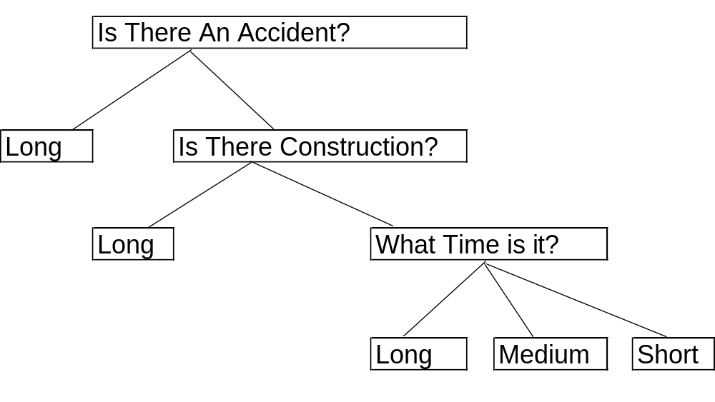
Decision Tree Example – Will I have a Long Commute?

Slide 5
Decision Tree Algorithms
Decision trees are built based on training data
The two most popular tree building algorithms are
  CART (Classification and Regression Trees)
  C5.0 (formerly C4.5 formerly ID3) – Named by a mathematician and not a marketing wizard!
Both are one-pass, recursive, greedy algorithms

Slide 6
In other words
Builds the tree in a single readthrough of the data, rather than continually querying it.
Recursively builds each subtree
Greedy algorithms are not necessarily optimal but they take the biggest bite possible at each step
Remember we saw greedy algorithms in studying minimal spanning trees for example

Slide 7
What’s meant by a “greedy” in this context?
We can think of a decision tree like the game ‘20 questions’ where you try to figure out an object someone is thinking about in 20 questions or less.
A child may be quite naïve about this and ask questions like, ‘is it my mom?’ or ‘is it my dad?’ or ‘is it my dog?’ Each of these questions eliminates very little of the potential population.
A more sophisticated player will ask questions like ‘is it dead or alive?’ ‘is it a mammal?’ or ‘is it bigger than a breadbox?’
Each of the latter questions cuts the population down greatly each time and can be considered ‘greedy’

Slide 8
Decision Tree Pseudocode
Commuting Example
  Target is commute time: (short, medium, long)
  Attributes are a list of variables like CommuteTime=(8,9,10), isConstruction=(Y,N), isAccident=(Y,N)
  Examples are a set of previous commutes with values for each attribute
Steps
  Algorithm finds best attribute is isAccident, creates 2 subtrees by calling itself with one tree containing all examples where isAccident is yes and one where isAccident is no.
  For the yes subtree the algorithm realizes all examples have long commute times so it returns a leaf node with long as the target
  For the no subtree it finds the best attribute among remaining attributes is isConstruction…

Slide 9
Decision Tree Pseudocode (II)
node LearnTree(examples, target, attributes){
//examples is the training set
//target is what to learn
//attributes is the set of available attributes that we decide on at each step
//returns a tree node
if all the examples have the same target value
return a leaf with that value
else if the set of attributes is empty
return a leaf with the most common target value among examples //majority voting. (avoid)
else{
A = the “best” attribute among attributes having a range of values v1, v2, …, vk
//what is meant by best is the difference between CART and C4.5 Algorithms
Partition examples according to their value for A into sets S1, S2, …, Sk
Create a decision node N with attribute A
for i = 1 to k{ //decision has multiple paths but 2 or 3 is most typical
Attach a branch B to node N with test V_{i}
if S_{i} has elements (is non-empty)
Attach B to LearnTree(S_{i}, target, attributes – {A}); //recurse on reduced list
else
Attach B to a leaf node with most common target
}
return decision node N
}
}

Slide 10
Decision Tree Pseudocode (III)
When does the algorithm stop?
  When all remaining data has the same target value (e.g. yes or no. Returns a leaf node with that decision and stops)
  When we are out of attributes to test. (e.g. if remaining data has 3 yes and 2 no we return yes with potentially a probability 3/5. Up to implementer. Decision trees do not do well with noisy or inconsistent data!)
  When we run out of examples
The ‘best’ function is the heart of the algorithm. First we will discuss how the CART best function works.
Caution: complicated formulas ahead!

Slide 11
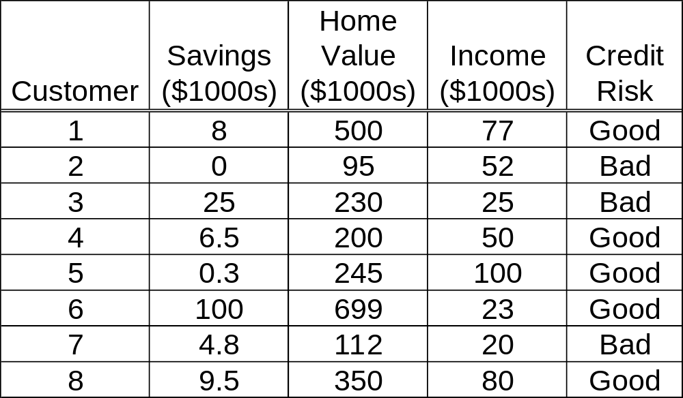
Training Data Used to Predict Credit Risk for a Bank Loan
We must change the ‘continuous data’ to ranges or Low, Medium, High or similar

Slide 12
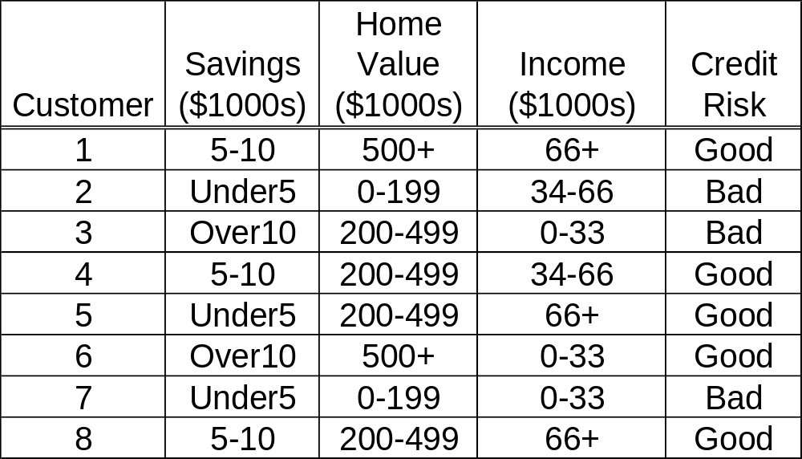
Modified Training Data
We could use more categories or ranges, but that would be a bit silly with only 8 data points

Slide 13
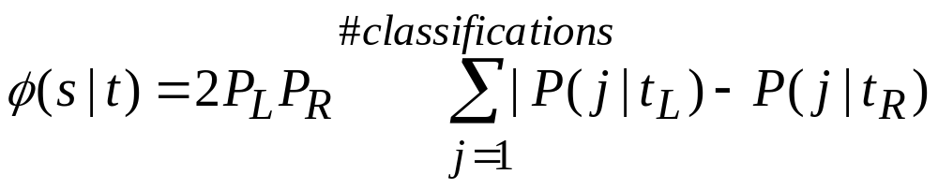
CART
(Classification and Regression Trees)
Only makes binary trees
Every attribute will have a potential left and right child node
Greedy part is the split that maximizes the equation
We’ll define all of these variables next

Slide 14
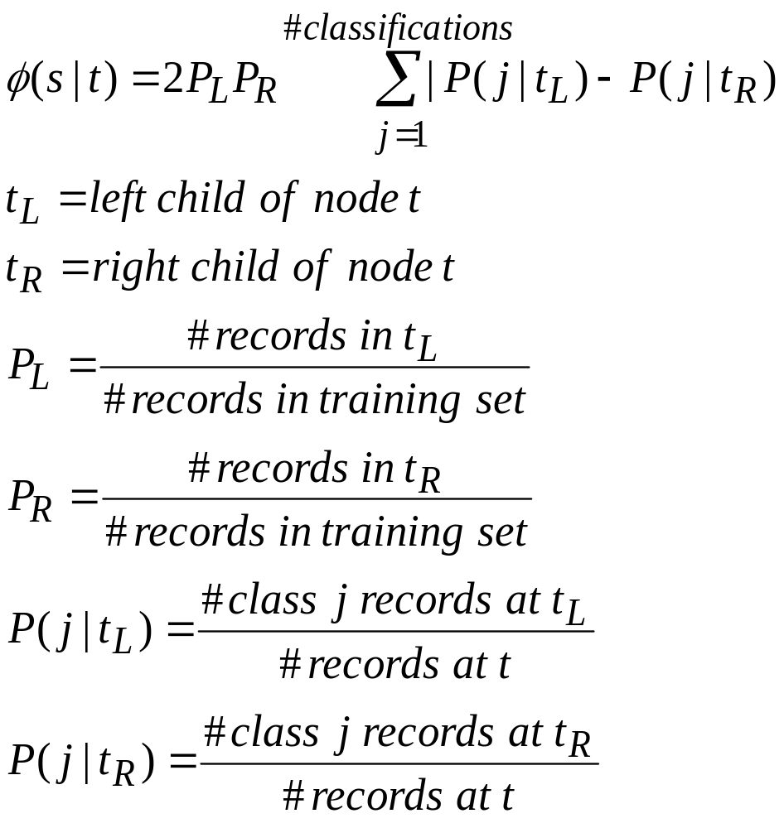
CART (II)

Slide 15
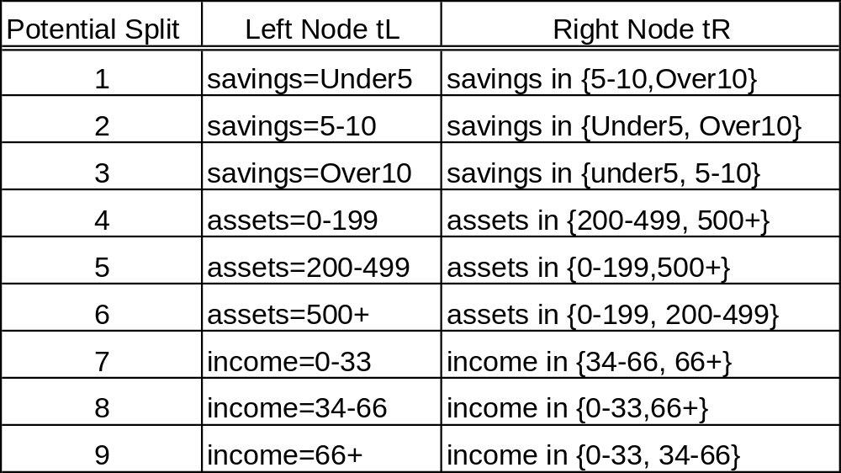

Potential Splits for t = root node
Now we just have to figure out which of these maximizes

Slide 16
Potential Split 1 Example
Left Child is Savings=Under5, Right Child is {5-10, Over10}
PL=(3 records with savings under5 / 8 examples total)=3/8
PR=(5 records with savings in {5-10,Over5}=5/8
P(j|TL) = 1/3 for good credit, 2/3 for bad credit
P(j|TR) = 4/5 for good credit, 1/5 for bad credit
2PLPR= 2(3/8)(5/8)
Sum=|1/3-4/5|+|2/3-1/5|
Φ(s|t)=2PLPR*Sum=(2(3/8)(5/8))*(|1/3-4/5|+|2/3-1/5|)
We compute φ for each of the 9 cases on the previous slide and choose the largest

Slide 17
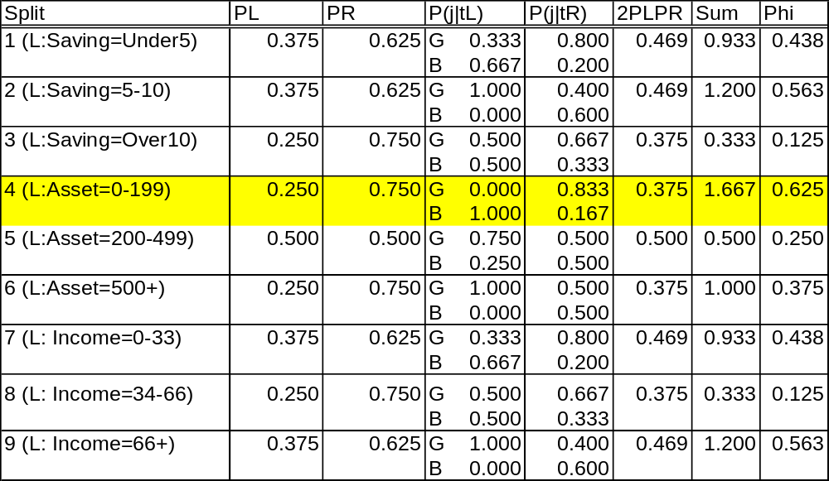
All Splits for Root Node
So the first split is on Assets (Home Value) 0-199. The example data records 2 and 7 go in left tree and become a node with target equal bad.
It then builds a new tree on the right based on example records 1, 3, 4, 5, 6, 8. (Note we have to recompute the remaining records over again. The probabilities above change each time)

Slide 18
Next Time
We’ll talk about entropy and c4.5
We’ll look at the R implementation of decision trees
We’ll talk about over-fitting and pruning

